Slide 1
Agile Behaviour Driven Development (BDD) and Integrated Testing with the Cucumber Framework
Damian Versaci
Melbourne ANZTB SIGIST, 15th June 2011

Slide 2

Contents
The Importance of Requirements
  Behaviour Driven Development (BDD) Explained
    BDD Frameworks (Cucumber, JBehave etc)
    Structure of a Feature File (User Story) & Workflow
  Benefits
  Potential Pitfalls
Image: http://community.travelchinaguide.com/forum2.asp?i=58724

Slide 3
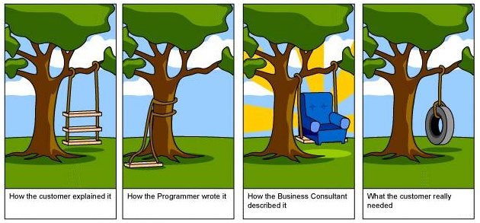
The Importance of Requirements
NIST estimate 70% of defects are introduced in the requirements phase¹
Earlier Detected Defects, Cheaper to Correct but prevention even better
Defining & Managing Requirements is generally a difficult exercise
      Requirements Elicitation, Elaboration, Validation & Acceptance
      Requirements Traceability (Code & Tests) & Change
1 National Institute of Standards & Technology (NIST) 2002 RTI Project 7007.011
Image: http://www.jacobsen.no/anders/blog/archives/images/project.html

Slide 4
Behaviour Driven Development (BDD) Explained
  Encourages Collaboration between Business Analysts, QA Engineers, Developers & Business Owners / Stakeholders
  Driven by Business Value
  Extends Test Driven Development (TDD) by utilizing natural language that non-technical stakeholders can understand
  BDD Frameworks such as Cucumber or JBehave are an Enabler, acting a “bridge” between Business & Technical Language
      User Stories & Acceptance Criteria Defined in Feature Files with Business Language
      Developers Implement Acceptance Criteria

Slide 5
BDD Frameworks (Cucumber, JBehave etc)
  Cucumber is designed for scenario implementation in Ruby, but supports other implementations
  JBehave is designed for scenario implementation in Java
  Highly Flexible, with ability to integrate with any tool supported by underlying implementation, e.g.
        Web Automation (Selenium / Waitr / Capybara)
        Various Languages (Java, .NET etc) with Cuke4Duke etc
        Build Systems – Ant, Rake, Hudson etc
        Various other Tools & Scripting toolkits

Slide 6
BDD Frameworks
    Basic .feature (User Story) Structure:
  Feature: [Title]
  As a [Role]
  I want [Some Action]
  So that [Business Value]
  Scenario: Title
  Given [Context]
  And [More Context]
  When (I do) [Action]
  And [Other Action]
  Then (I should see) [Outcome]
  And [More Outcomes]
  - Description of Feature
  - Stakeholder and/or User role
  Action to be taken by user.
  Business Value Provided
  Description of Scenario
  Preconditions of Scenario
  Actions taken in Scenario
  Outcome Expected
  One or more Scenarios defined

Slide 7
Structure of a Feature File & Agile Workflow
  Step 1: User Story / Requirement Elicitation & Elaboration
  with Customer(s) or Business Owner – Feature file output
  Step 2: User Story (Feature file) Elaboration &
  Validation with QA
  Step 3: Feature & Feature File Implementation by
  Developers
  Step 4: Testers Test Functionality
  Step 5: Acceptance by Business Owner
  Step 6: Repeat (In Event of Requirement Changes)

Slide 8
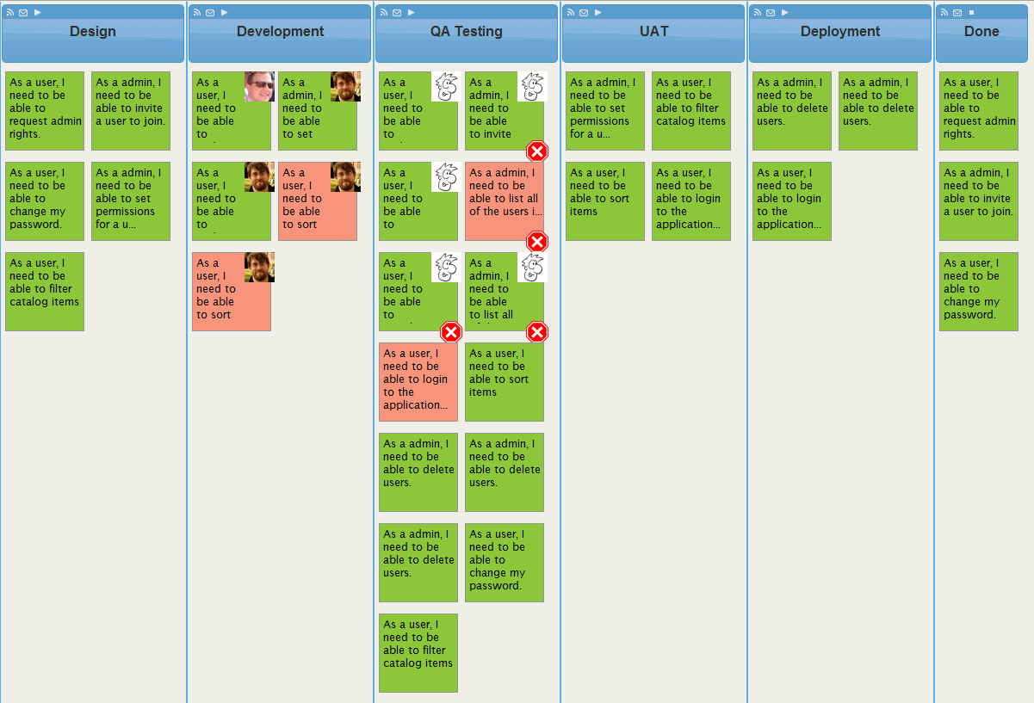
Structure of a Feature File & Agile Workflow
Image: http://leankitkanban.com/Content/Images/Features/visualizeTheWorkStuckInQA.png

Slide 9
Structure of a Feature File & Agile Workflow
  Step 1: User Story / Requirement Elicitation & Elaboration with Customer(s) and BA
Feature File Output:
  Scenario: Import File Successfully
  Given no data exists for today
  When I import the file
  Then the file data is stored successfully for
  future retrieval
  Scenario: View Usage Report
  Given file import has been completed
  When I generate a report for today
  Then a report should be generated
  And I should see the data from the file in the
  report
  fileimport.feature
  @story(“Report-01")
  @Ownership("BA")
  @wip
  Feature: Import Daily Data File
  As a Batch Data User
  I want to import usage data files
  So that usage data is available
  in reports

Slide 10
Structure of a Feature File & Agile Workflow
  Step 2: Elaboration & Validation with BA & QA Engineer
Feature File Output:
  Scenario: Data Already Exists
  Given data exists for the imported file date
  When I import the file
  Then previously imported data is deleted
  And the file data is stored successfully for
  future retrieval
  … more scenarios …
  Scenario: View Usage Report
  Given file import has been completed
  When I generate a report selecting a
  specific date
  Then a report should be generated
  And I should see data for the date specified
  fileimport.feature
  …feature…
  Scenario: Import File Successfully
  Given no data exists for the imported
  file date
  When I import the file
  Then the file data is stored successfully for
  future retrieval

Slide 11
Structure of a Feature File & Agile Workflow
  Step 3: Developers Implement Functionality & Scenario
  Acceptance Criteria
  FileImport.rb
  … Other Implementation details …
  Then /^I should see data for the date specified $/ do
  date = filefeed.date
  text = “Units Purchased = 15, Total Cost = $500.00”
  xpath="/descendant::header[@class='page'][#{page_number}]/h1"
  Then "I should see \"#{text}\" within path \"#{xpath}\""
  end
  Then /^(?:|I )should see \/([^\/]*)\/(?: within path "([^"]*)")?$/ do |regexpression, xpath|
  regexp = Regexp.new(regexpression, {}, 'U')
  if page.respond_to? :should # Using Capybara Web Driver
  page.should have_xpath(xpath, :text => regexp)
  else
  assert page.has_xpath?(xpath, :text => regexp)
  end
  end

Slide 12
Structure of a Feature File & Agile Workflow
  Step 4: Testers Test Functionality
  Exploratory Testing and / or Define own Cucumber Tests:
  fileimport.feature
  @story(“Report-01")
  @Ownership(“QA") @wip
  Feature: Import Daily Data File
  As a Batch Data User
  I want to import usage data files
  So that usage data is available in reports
  Scenario: Import File Successfully
  Given the following data exists
  | Date | Units | Cost |
  | 24-03-2010 | 0 | 0 |
  | 25-03-2010 | 12 | 500.00 |
  When I import the file containing data
  | Date | Units | Cost |
  | 24-03-2010 | 6 | 200.00 |
  Then the following data is stored for future retrieval
  | Date | Units | Cost |
  | 24-03-2010 | 6 | 200.00 |
  | 25-03-2010 | 12 | 500.00 |

Slide 13
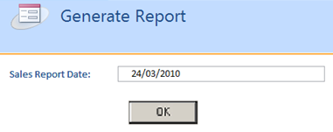
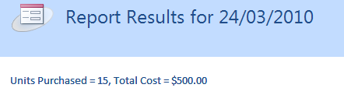
Structure of a Feature File & Agile Workflow
  Step 4: Testers Continued
  Scenario: View Usage Report
  Given file import has been completed
  When I generate a report for <date>
  Then a report should be generated
  And I should see <data> displayed
  Examples:
  | date | data |
  | 24-03-2010 | Units Purchased = 15, Total Cost = $500.00 |
  | 25-03-2010 | Units Purchased = 6, Total Cost = $200.00 |

Slide 14
Structure of a Feature File & Agile Workflow
  Step 5: Acceptance by Business Owner
  Confidence that Acceptance Criteria has been implemented via Scenario implementation, Automated Tests by Testers & Integrated with Build System
  Demo & Acceptance (Business Signoff) of Functionality
  Showcases

Slide 15
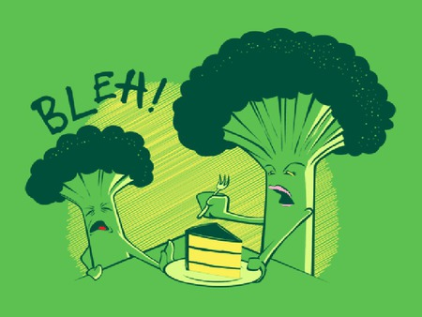
Structure of a Feature File & Agile Workflow
  Step 6: Repeat (In Event of Requirement Changes)
Feature Files are Modified “Breaks the Build”
Developers Implement new functionality to make tests “Pass”
Testers test new functionality
Business Owner Accepts Functionality
Image: http://shirtoid.com/wp-content/uploads/2010/08/Bleh-Broccoli.jpg

Slide 16
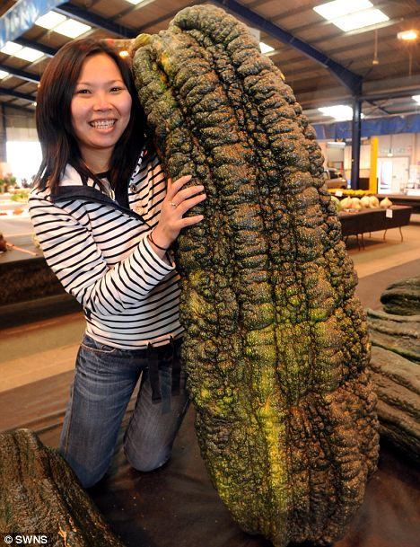
Benefits
    Requirements are easy to understand for both Business Stakeholders and Technical Project Members
    Quality is “Built-in”, assessing requirements quality at the beginning of the process (Elicitation, Elaboration, Validation & Acceptance)
    Allows easy adaptation to requirements changes
    Testers can leverage and extend developers work
    Traceability is relatively easy
Image: http://www.onlineweblibrary.com/news/cucumber.jpg

Slide 17
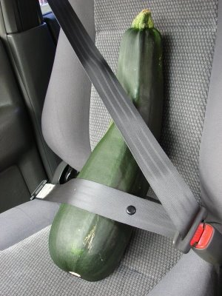
Potential Pitfalls
    BDD is a Mindset, Not a Set of Tools
    Tools are immature
    Requirements / Functionality Influenced by Consensus
    Not suitable for all project types
    Is Not a Replacement for Unit Testing
    Need to be Mindful of Stakeholders When Wording Features & Scenarios
    Make Sure Features are Broken Down into Sufficiently small “chunks”
Image: http://1.bp.blogspot.com/_8M4A38LyBBs/SI4DVmgay5I/AAAAAAAAAdk/cqJ7Gx4-Bf8/s400/5.jpg

Slide 18
Further Reading
The RSpec Book: Behaviour Driven Development with Rspec, Cucumber, and Friends
http://www.amazon.com/RSpec-Book-Behaviour-Development-Cucumber/dp/1934356379
    Cucumber Website - http://cukes.info/
    Cuke4Duke (Cucumber for Java) - https://github.com/aslakhellesoy/cuke4duke/wiki
    JBehave Website - http://jbehave.org/
    Webrat (Web Driver) - https://github.com/brynary/webrat/wiki
    Capybara (Web Driver that extends Webrat)
      http://rubydoc.info/github/jnicklas/capybara/master/file/README.rdoc
      http://www.allenwei.cn/cucumber-capybara-what-we-need-for-rails-integration-test/
    HTMLUnit – Browser Simulation for Java: http://htmlunit.sourceforge.net/
    Culerity (Cucumber wrapper for HTMLUnit) - https://github.com/langalex/culerity/wiki

Slide 19

Questions?
Image: Clipart

